Slide 1
FACTORS AND FACTORIALS

Slide 2
Factors
Concepts of Factors and Multiples
Factorials
Number of zeroes in a factorial
Number of factors
Sum of factors
Product of factors
Number of odd and even factors
Highest power of a number in a factorial
Concept of Number of Zeros

Slide 3
Factors and Multiples : All the numbers that divide a number completely, i.e., without leaving any remainder, are called factors of that number. For example, 24 is completely divisible by 1, 2, 3, 4, 6, 8, 12, 24. Each of these numbers is called a factor of 24 and 24 is called a multiple of each of these numbers.
FACTORS

Slide 4
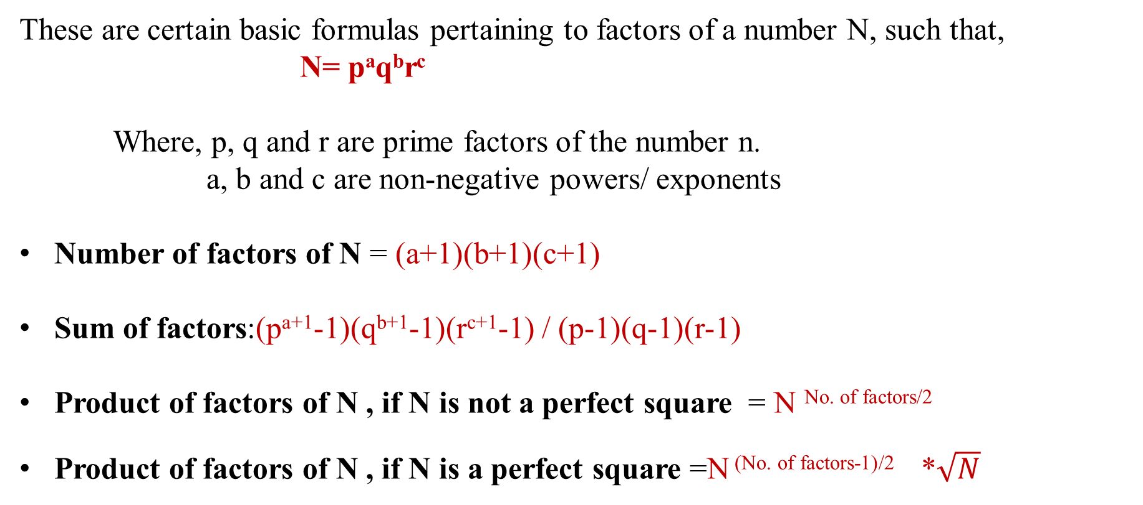
FACTORS
These are certain basic formulas pertaining to factors of a number N, such that,
N= pªq^{b}r^{c}
Where, p, q and r are prime factors of the number n.
a, b and c are non-negative powers/ exponents
Number of factors of N = (a+1)(b+1)(c+1)
Sum of factors:(p^{a+1}-1)(q^{b+1}-1)(r^{c+1}-1) / (p-1)(q-1)(r-1)
Product of factors of N , if N is not a perfect square = N ^{No. of factors/2}
Product of factors of N , if N is a perfect square =N ^{(No. of factors-1)/2} *$\sqrt{N}$

Slide 5
FACTORS
Number of even Factors and odd factors:
Let N as a number.
N in prime factorization = a^p × b^q × c^r
No. of factors of N = (p+1)(q+1)(r+1)
Now suppose that b and c are odd prime numbers in prime factorization of N
Now to find even no of factors you have to find odd no of factors first.
Odd no of factors = (q+1)(r+1)
Even no of factors = (total no of factors) - (odd no of factors).

Slide 6
FACTORS
1. What is the number of factors of 1125?
A. 8 B. 12 C. 22 D. 24
Notes:
Difficulty Level: Easy
Option B
Compulsory

Slide 7
FACTORS
2. What is the number of factors of $2^{6}$x$3^{3}x7^{3}$
A. 28 B. 36 C. 64 D. 112
Notes:
Difficulty Level: Easy
Option D
Compulsory

Slide 8
FACTORS
3. What is the number of factors of $4^{2}$x$9^{3}$ x${10}^{3}$?
A. 112 B. 890 C. 224 D. 160
Notes:
Difficulty Level: Easy
Option C

Slide 9
FACTORS
4. What is the sum of the factors of 72?
A. 220 B. 145 C. 195 D. 260
Notes:
Difficulty Level: Moderate
Option C
Compulsory

Slide 10
FACTORS
5. What is the sum of the factors of 600?
A.1560 B. 1650 C. 1770 D. 1860
Notes:
Difficulty Level: Moderate
Option D
Compulsory

Slide 11
FACTORS
6. What is the product of the factors of 361?
A. 19^5 B. 19^3 C. 19^10 D. None
Notes:
Difficulty Level: Moderate
Option B
Compulsory

Slide 12
FACTORS
7. What is the product of the factors of 1024?
A. 2^58 B. 2^36 C. 2^55 D. None
Notes:
Difficulty Level: Moderate
Option C
Compulsory

Slide 13
FACTORS
8. What is the product of the factors of 360?
A. 360^12 B. 360^8 C. 360^16 D. None
Notes:
Difficulty Level: Moderate
Option A

Slide 14
FACTORS
9. What is the product of the factors of 524?
A. 524^2 B. 524^3 C. 524^6 D. None
Notes:
Difficulty Level: Moderate
Option B

Slide 15
FACTORS
10. Find the smallest number that has exactly 18 factors?
A. 156 B. 180 C. 360 D. 760
Notes:
Difficulty Level: Difficult
Option B
Compulsory

Slide 16
FACTORS
11. Find the odd factors of 252?
A. 8 B. 5 C. 7 D. 6
Notes:
Difficulty Level: Moderate
Option D
Compulsory

Slide 17
FACTORS
12. How many factors of 2^4 * 5^3 * 7^4 are odd numbers?
A. 20 B. 25 C. 27 D. 29
Notes:
Difficulty Level: Moderate
Option A
Compulsory

Slide 18
FACTORS
13. Number N = 2^6 * 5^5 * 7^6 * 10^7; how many factors of N are even numbers?
A.1183 B. 1173 C. 1673 D. 190
Notes:
Difficulty Level: Moderate
Option A
Compulsory

Slide 19
Number of zeroes: It is very easy to find the number of zero at the end , all you have to do is count how many times did 2 and 5 occurred in the question as factor. Number of zeros is equal to the one (2 or 5)which occurred less times. i.e. 2*5 = 10 2*2*5*5 = 100 So the number of zeros depends upon the number of pairs of 2 and 5. Example 1. How many numbers of zeros will be there at the trail (end) of the 1*2*3*4*5*6*7*8*9*10? Solution: In given expression number of 2’s = 8 Number of 5’s = 2 So total number of pairs = 2 Two zeroes will be there at the end of the calculation.
FACTORIALS

Slide 20
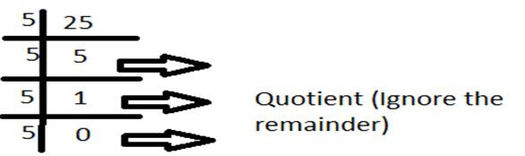
Number of zeroes in a factorial:
FACTORIALS
There will be 5+1+0 = 6 zeroes at the end of 25!

Slide 21
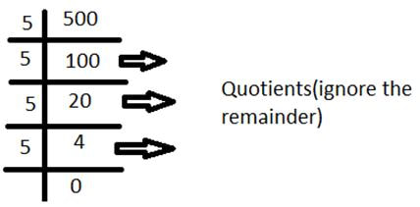
FACTORIALS
Example . Find the number of zeros at the end of 500!
Solution:
Total number of 5’s = 100+20+4 = 124

Slide 22
14. The highest power of 3 that completely divides 43! is:
A] 19 B] 26 C] 16 D] 15
FACTORIALS
Notes:
Difficulty Level : Difficult
Option: A
Compulsory

Slide 23
15. What is the highest power of 7 in 100 factorials?
A] 16 B] 12 C] 21 D] 23
FACTORIALS
Notes:
Difficulty Level : Difficult
Option: A
Compulsory

Slide 24
16. What is the highest power of 7 in 100 factorials?
A] 16 B] 12 C] 21 D] 23
FACTORIALS
Notes:
Difficulty Level : Difficult
Option: A
Compulsory

Slide 25
FACTORIALS
17. What is number of trailing zeroes in 12135000?
A] 0 B] 2 C] 3 D] 5
Notes:
Difficulty Level : Easy
Option: C

Slide 26
FACTORIALS
18. What is number of trailing zeroes in 121350001?
A] 0 B] 2 C] 3 D] 5
Notes:
Difficulty Level : Easy
Option:A

Slide 27
19. Find the number of zeros in 182! ?
A] 44 B] 42 C] 51 D] 48
FACTORIALS
Notes:
Difficulty Level : Difficult
Option: A
Compulsory

Slide 28
20. Find the number of zeros in 532! ?
A] 144 B] 142 C] 131 D] 148
FACTORIALS
Notes:
Difficulty Level : Difficult
Option: C
Compulsory

Slide 29
21. What is the number of trailing zeroes in 1173!
A] 214 B] 233 C] 265 D] 290
FACTORIALS
Notes:
Difficulty Level : Moderate
Option: D
Compulsory

Slide 30
FACTORIALS
22. Find the No. of zeroes at the end of 2^7 × 3^5 × 5^8 × 7^5 × 8^3 × 10^5.
A] 13 B] 17 C] 15 D] 20
Notes:
Difficulty Level : Moderate
Option: A
Compulsory

Slide 31
FACTORIALS
23. Which of the following cannot be the number of zeroes at the end of any factorial?
A] 25 B] 26 C] 30 D] 36
Notes:
Difficulty Level : Moderate
Option: C

Slide 32
FACTORIALS
24. If the number of zeros are 117 for the number x!, then find the least value of x?
A] 289 B] 326 C] 430 D] None
Notes:
Difficulty Level : Expert
Option: D

Slide 33
Any Doubts???

